Slide 1


AZ-900
Microsoft Azure Fundamentals

Slide 2
Azure Storage Services
In this module, you'll learn about the different Azure storage options and the scenarios in which each is appropriate.
Azure Storage Service
Azure Table Storage
Azure Queue Storage
Learning Objectives
Azure File Storage
Azure Blob Storage
Azure Storage Data Redundancy
Storage Access Tiers
Disk Storage

Slide 3
Azure Storage Services
In this module, you'll learn about the different Azure storage options and the scenarios in which each is appropriate.
Azure Storage Explorer
Azure Import and Export Service
File Sync
Learning Objectives
AzCopy
Azure Migrate
Azure Data Box

Slide 4

Azure Storage Service
Fast, reliable, and private connection to Azure

Slide 5
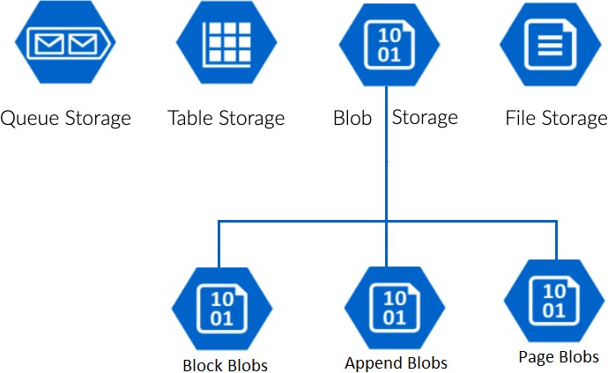
Azure Storage Service
Diff types of data and requirements
Relational, non-relational/No-SQL, datasheets, images, videos, backups
Storage, access, security, availability, latency, processing, backup
Diff types of Data Service
Azure Blobs: Text and binary data
Azure Files: Managed file shares (SMB Protocol)
Azure Queues: Messaging
Azure Tables: NoSQL store
Features
Durable and highly available – redundancy across datacenters or regions
Secure – all data encrypted by default
Scalable – massively scalable
Managed - Azure handles hardware maintenance, updates, and critical issues for you.
Accessible - accessible from anywhere in the world over HTTP or HTTPS.
Clients libraries are available in all languages
Support scripting in PowerShell or Azure CLI

Slide 6

Azure Storage Data Redundancy
Protect your data from hardware failures, network or power outage, and natural disasters

Slide 7
Azure Data Redundancy
Protect your data from hardware failures, network or power outages, and massive natural disasters.
Even in the event of a failure, redundancy ensures your storage account's availability and durability.
Tradeoffs between lower costs and higher availability
Redundancy in the primary region
Locally redundant storage (LRS) – Three synchronous copies in same data center
Zone-redundant storage (ZRS) – Three synchronous copies in three availability zones (AZs)
Redundancy in a secondary region
Geo-redundant storage (GRS) – LRS + Asynchronous copy to secondary region ()
Geo-zone-redundant storage (GZRS)
With GRS or GZRS, the data in the secondary region isn't available for read or write access unless there is a failover to the secondary region.
For read access to the secondary region, configure your storage account to use
Read-access geo-redundant storage (RA-GRS)
Read-access geo-zone-redundant storage (RA-GZRS).

Slide 8

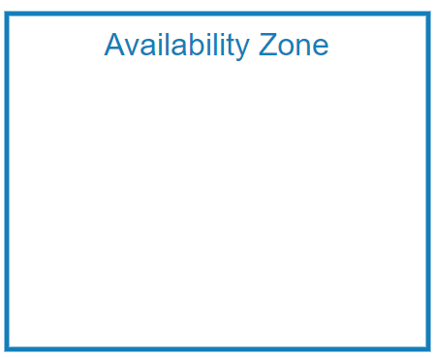



Azure Storage Redundancy
⮚

Slide 9
Azure Storage Redundancy
Locally redundant storage (LRS) – Three synchronous copies in same data center
Zone-redundant storage (ZRS) – Three synchronous copies in three availability zones (AZs)
Geo-redundant storage (GRS) - LRS + Asynchronous copy to secondary region (three more copies using LRS) – Read only access
Read-access geo-redundant storage (RA-GRS) – Read Access on GRS
Geo-zone-redundant storage (GZRS) – ZRS + Asynchronous copy to secondary region (three more copies using LRS) – Read only access
Read-access geo-zone-redundant storage (RA-GZRS) – Read Access on GZRS

Slide 10

Azure Blob Storage
Binary Large Object

Slide 11
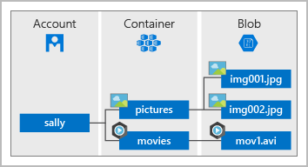
Blob Storage
Blob - Binary Large Object
Any type or format
Text, Images, audio, video, excel, backup files
Use cases:
Storing files for shared access
Video and audio streaming
Storing data for analysis (Data Lake Gen2)
Writing to the log file
Storing data for disaster recovery, backup, and archiving
Flat structure
Provides a unique namespace in Azure for your data.
http://mystorageaccount.blob.core.windows.net

Slide 12
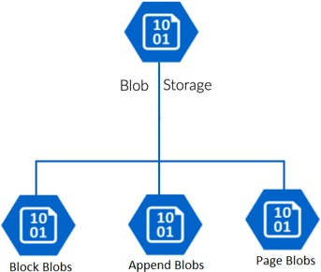
Three types of Blob Storage
Block Blobs:
For large objects that doesn't use random read and write operations, files that are read from beginning to end
Such as media files or image files for websites.
Page Blobs:
Optimized for random read and write operations.
Provide durable disks for Azure Virtual Machines (Azure VMs)
Append Blobs:
Optimized for append operations. e. g. Logs
When you modify an append blob, blocks are added to the end of the blob only
Updating or deleting of existing blocks is not supported
For example, you might write all of your trace logging to the same append blob for an application running on multiple VMs

Slide 13

Storage Access Tiers
Organize your data based on attributes like frequency of access and planned retention period.

Slide 14
Storage Access Tiers
Data stored in the cloud can be different based on how it's generated, processed, and accessed over its lifetime.
Pricing
Hot
The volume of data stored/month
⮚
⮚
⮚
⮚
Types of operations performed
Number of operations performed
Data transfer cost, if any
The selected data redundancy option
Cool
Organize your data based on attributes like frequency of access and planned retention period.
Blob access tiers
Hot access tier
⮚
⮚
Cool access tier
Archive
Archive access tier

Slide 15
Storage Access Tiers
Hot
Frequently accessed data
Example - images for your website Low latency
Higher access cost
⮚
⮚
Cool
Infrequent accessed data
Example - invoices for your customers
High latency
Lower cost
Stored for at least 30 days
Hot
Cool
Archive
Archive
Rarely accessed data
Fast Access Higher Cost
Slow Access Lower Cost
Example - long-term backups
Highest access times and access cost
Latency in hours
Stored for at least 180 days
Use Case: Business policy mandated Data Archiving, long term retention like healthcare data

Slide 16

Azure Table Storage
A NoSQL key-value store

Slide 17
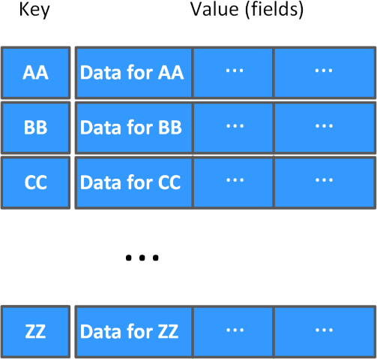
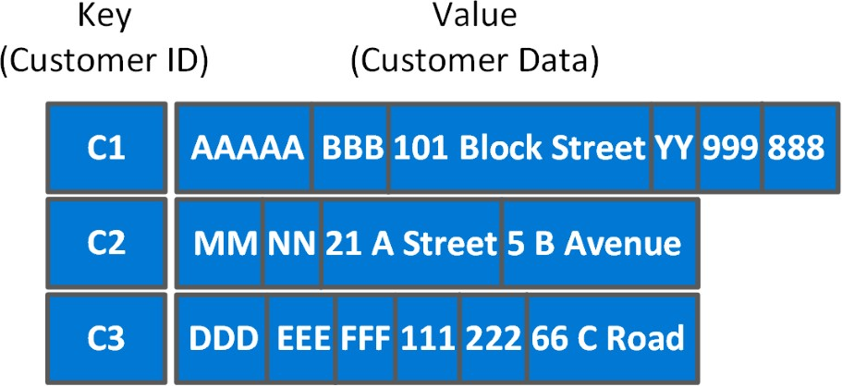
Azure Table Storage
NoSQL key-value Storage
⮚
⮚
⮚
⮚
⮚
⮚
⮚
⮚
Items are referred to as rows, and fields are known as columns
All rows in a table must have a key
No concept of relationships, stored procedures, secondary indexes, or foreign keys
Data will usually be denormalized
To help ensure fast access, Azure Table Storage splits a table into partitions
Support very large volume of Data
Consider Cosmos DB for new development
Advantages
It's simpler to scale
A table can hold semi-structured data
No complex relationships
Data insertion and retrieval is fast
Good to use for:
Storing TBs of structured data capable of serving web scale applications
Storing datasets that don't require complex joins, foreign keys, or stored procedures, and that can be denormalized for fast access.
Capturing event logging and performance monitoring data.
⮚

Slide 18

Azure Queue Storage
Message queuing service to store large numbers of messages.

Slide 19
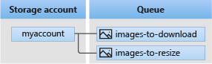
Azure Queue Storage
Store large numbers of messages.
⮚
⮚
⮚
Access messages via authenticated calls using HTTP or HTTPS.
May contain millions of messages, up to the total capacity limit of a storage account.
Queues are commonly used to create a backlog of work to process asynchronously.

